Slide 1
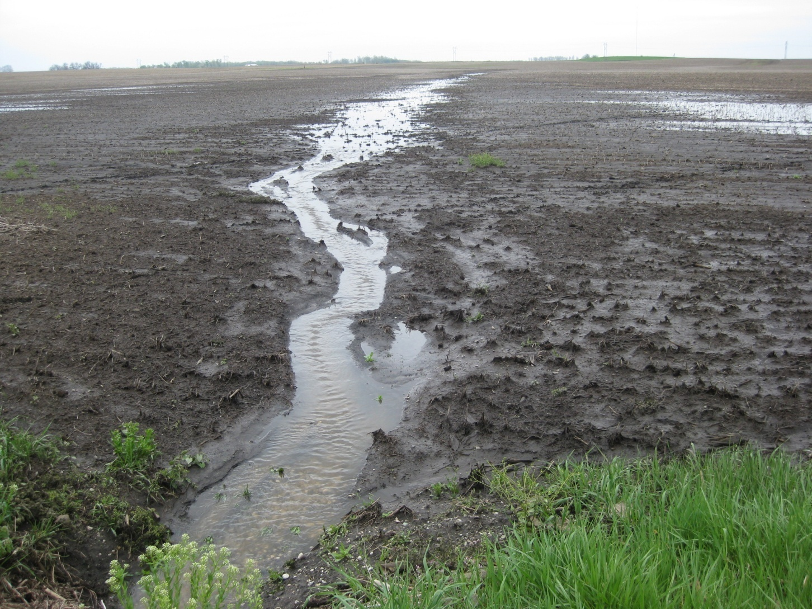
Conservation Practices to Reduce Nutrients in Water
Jane Frankenberger
Professor and Extension Agricultural Engineer
Agricultural & Biological Engineering
Purdue University

Slide 2
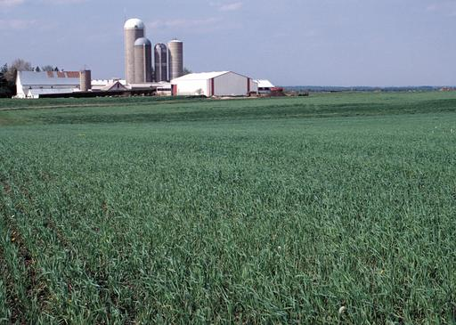
To change water quality, practices on the ground need to change.
Conservation practices or best management practices (BMPs) can reduce nutrient losses
Farmers are provided with payments from the public (NRCS, states, private sector, local groups) to change some aspect of their management.

Slide 3
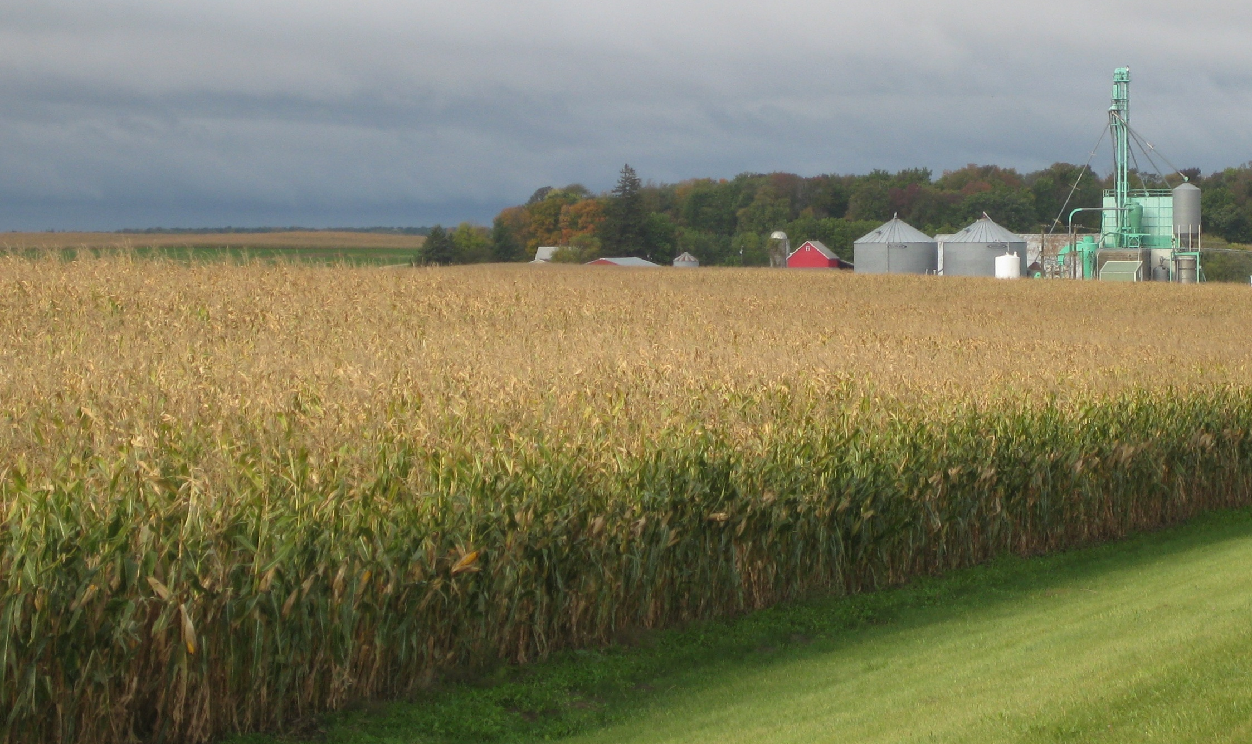
How is this corn field impacting water quality?

Slide 4
Water quality impacts occur
(1) When it rains
(2) When there is little vegetation

Slide 5
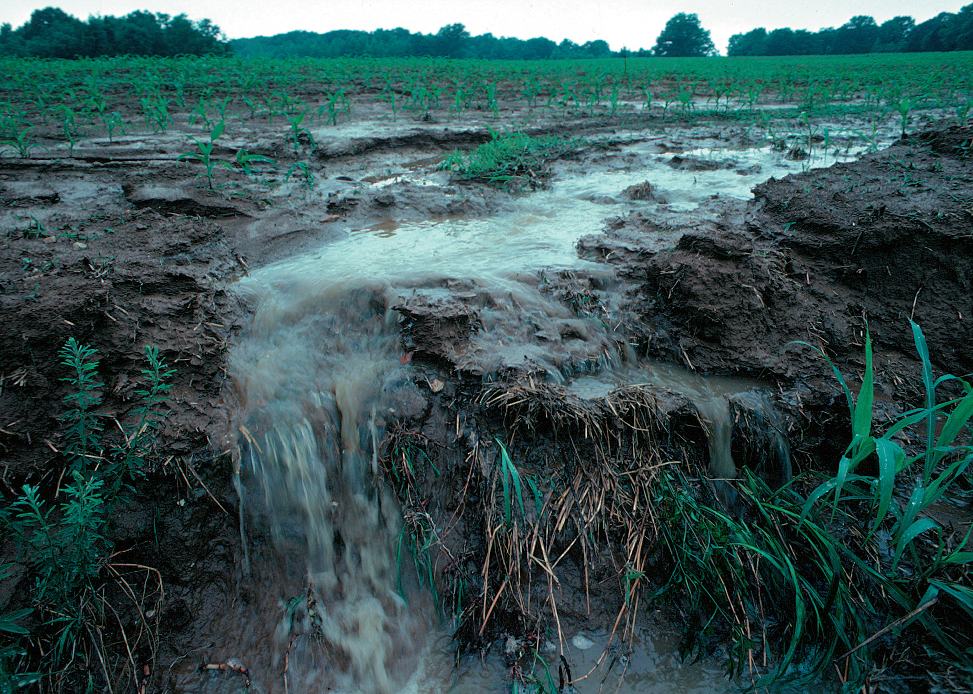
Soil erosion was the primary problem addressed for decades. It has been a primary focus of soil conservation programs
Image courtesy NRCS

Slide 6
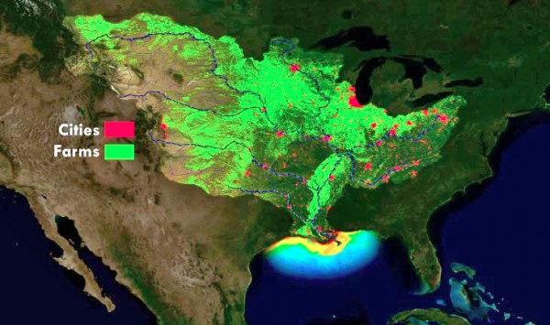
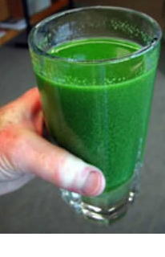
Critical national issues today are caused by DISSOLVED nutrients
Hypoxia in the Gulf of Mexico
Toxic algae in Lake Erie
August 2014 Headline:
“Toxin leaves 500,000 in northwest Ohio without drinking water”
Image from NOAA

Slide 7
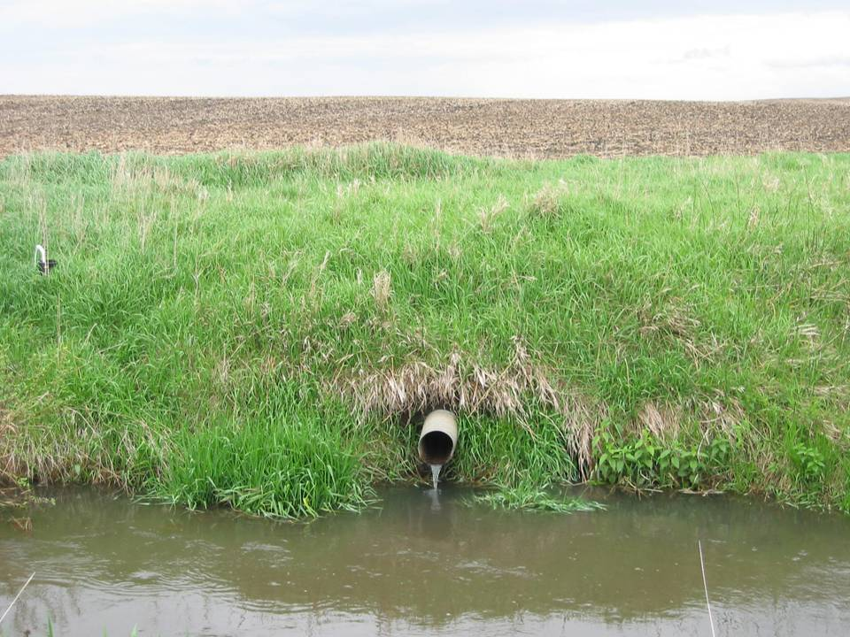
Nitrogen is not primarily linked to soil erosion but rather is lost in the dissolved form (nitrate).
Most moves through subsurface “tile” drains….
Photo: Dan Jaynes

Slide 8
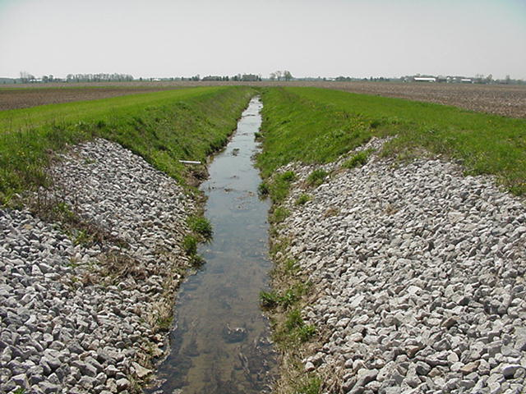
…that flow into drainage ditches like these.

Slide 9






How tile drainage works
Notes:
Controlled drainage, also known as drainage water management, gives farmers the ability to manage tile water by raising the outlet elevation using a water control structure during periods when drainage is unnecessary. This raises the water table in the field until it is higher than the outlet, when it can flow freely into the drain.

Slide 10
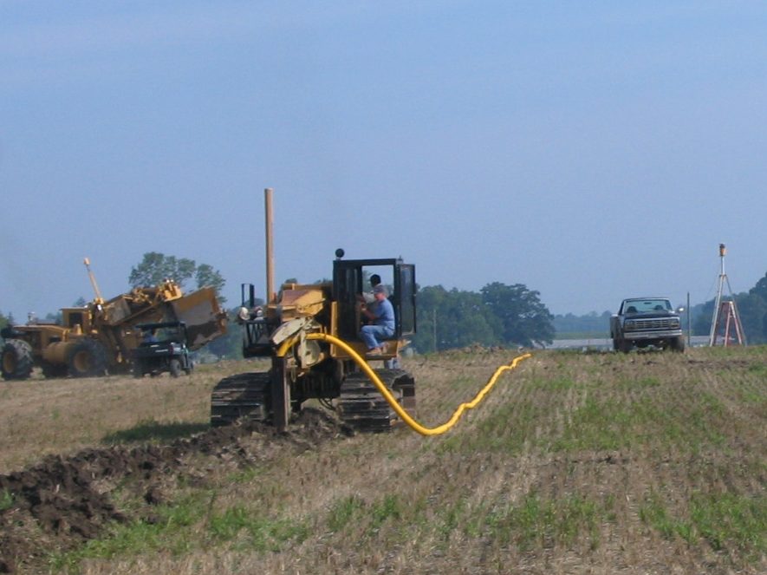

Tile drains exist on about half of Midwest farmland, and continue to be installed.

Slide 11
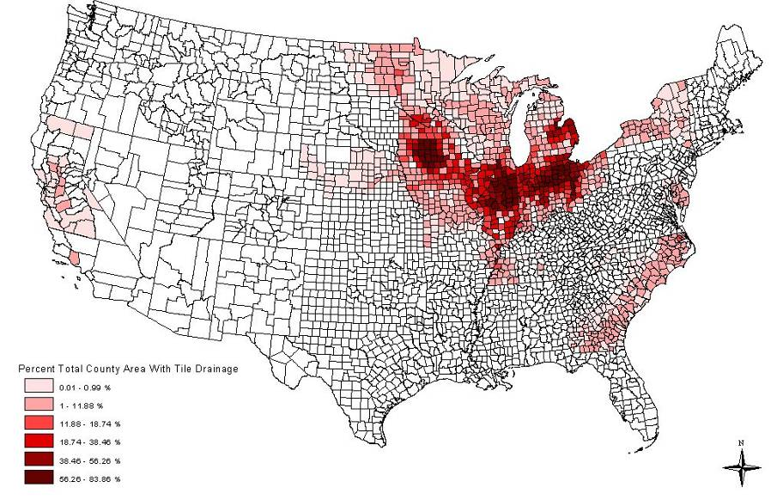
The North Central Region has most of the nation’s tile drainage.
Percent of acres tile drained
0-1%
>55%
Source: Zachary Sugg, World Resources Institute

Slide 12
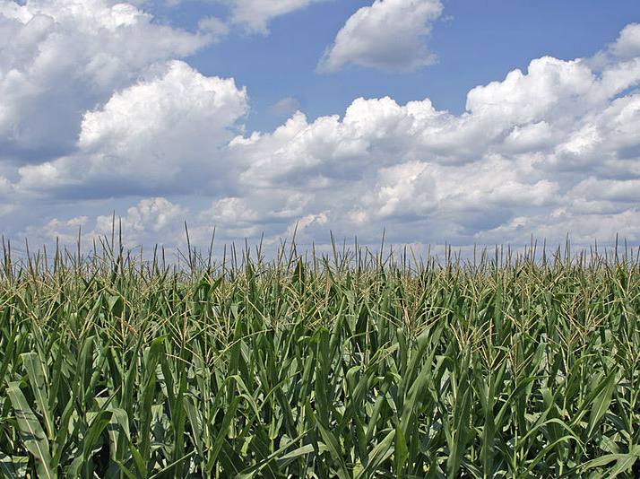
The Nutrient Reduction Game
What will it take to successfully implement a Nutrient Reduction Strategy?

Slide 13
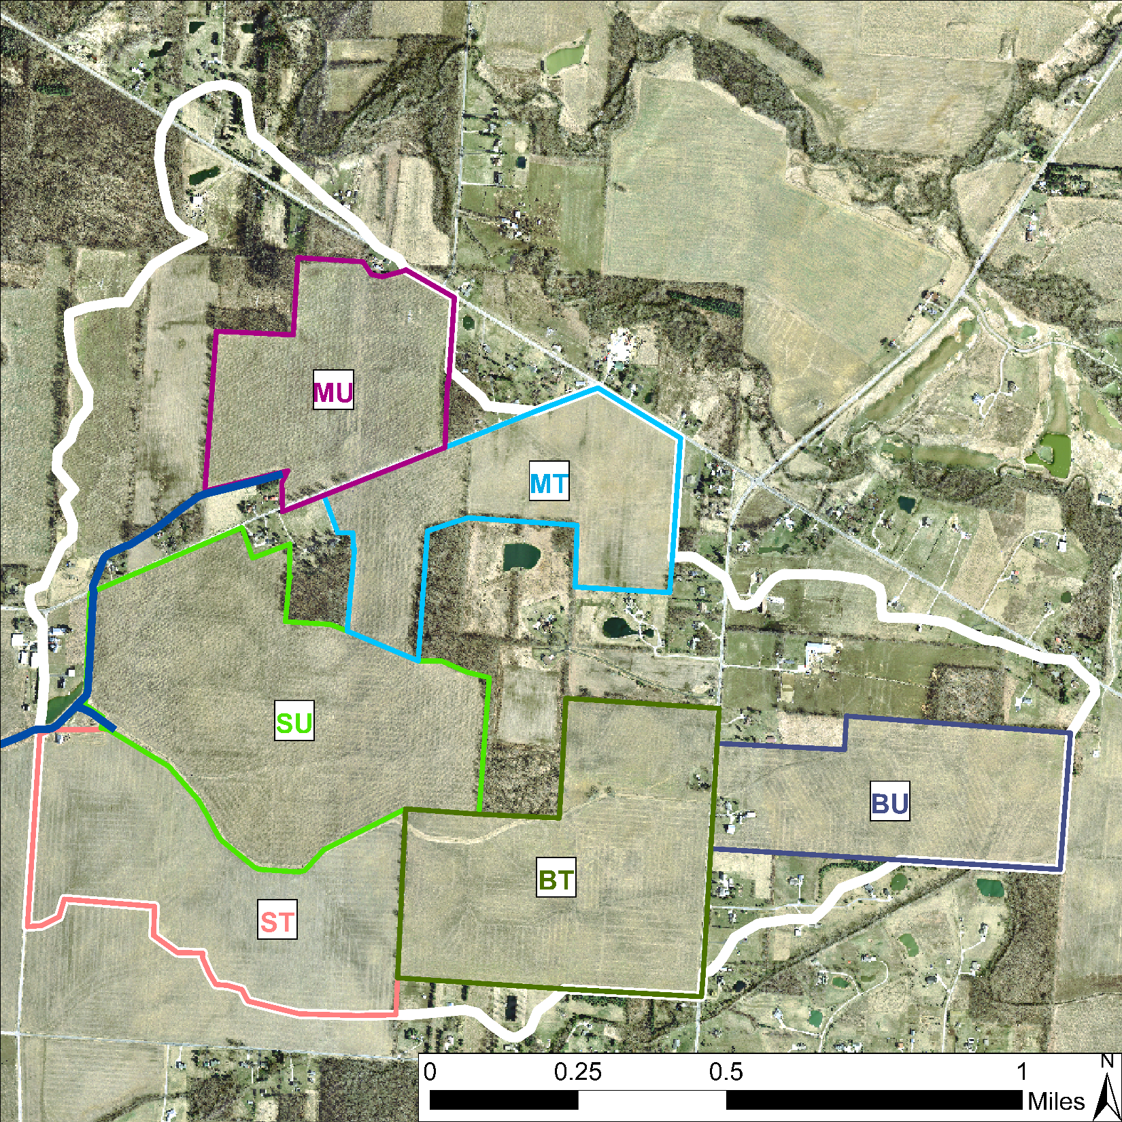


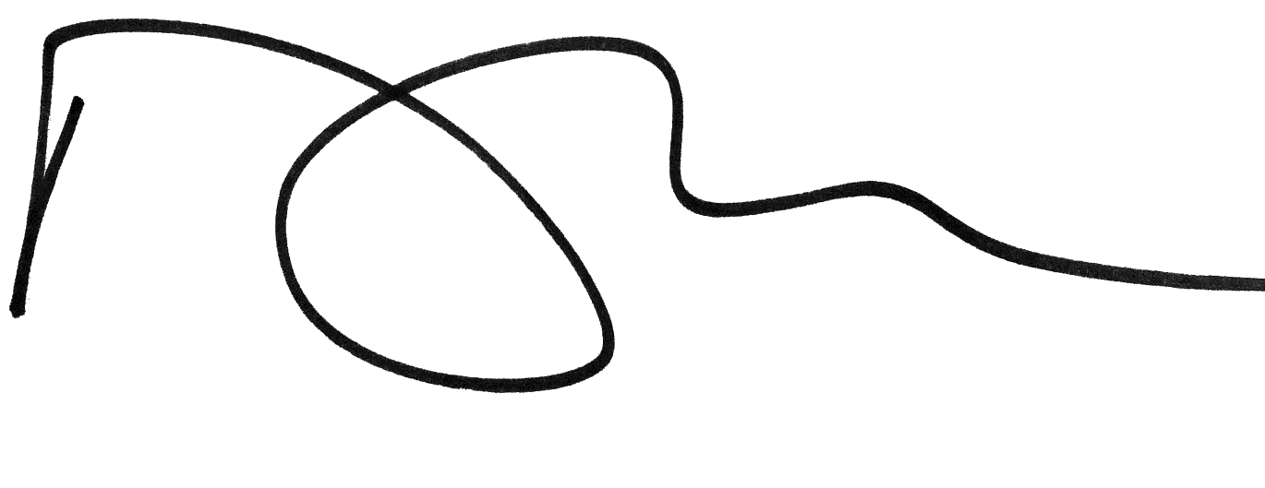
Farmers in the Green Ditch Watershed have formed a group.
They have received a $30,000 grant to reduce nitrogen load. Goal is 45% reduction.
Today
Green Ditch Watershed Ag Council.
$30K
Twenty thousand and 00/100

Slide 14
McDonald Farm (rented)
Brooks Big Farm
Sunshine Small Farm

Slide 15
To address agricultural water quality issues, we use conservation practices or best management practices (BMPs) that reduce nutrient losses
Farmers are provided with payments from the public to change some aspect of their management.

Slide 16
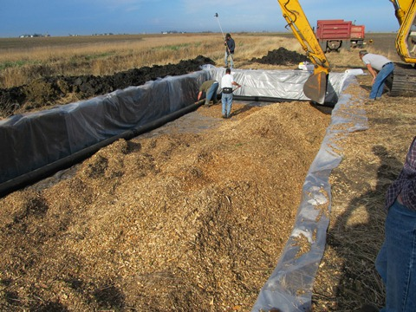
Each practice has a different (1)effectiveness and (2)cost
Effectiveness quantified by nitrogen load reduction
Cost quantified by $/acre treated
Photo courtesy L. Gentry, U of I

Slide 17
In this exercise, effectiveness and cost of potential conservation practices are roughly quantified.
Values from Iowa Nutrient Reduction Strategy Science Assessment
Nitrogen reduction was estimated as a percent, so reduction in pounds depends on initial value.
  Tile drained fields have loads about 10x higher than undrained, so also have different reductions.
Cost is for 4 years, to very roughly make practices more comparable.
Both of these are very rough!. Hopefully within 50% of actual values…. But at this point low reliability.

Slide 18
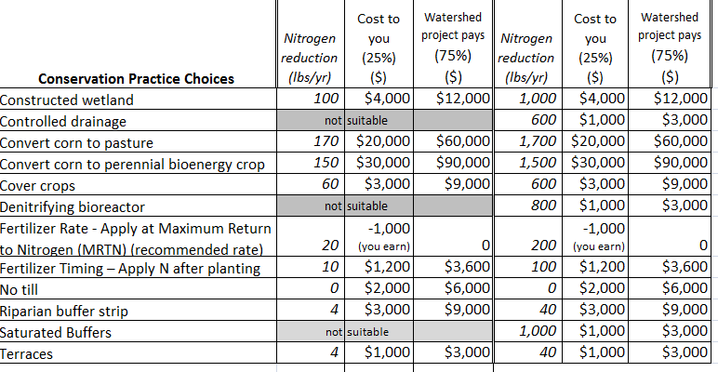
Nitrate Loss Reduction
COST
COST
To You
To Project
To You
To Project
UNDRAINED
TILE DRAINED

Slide 19
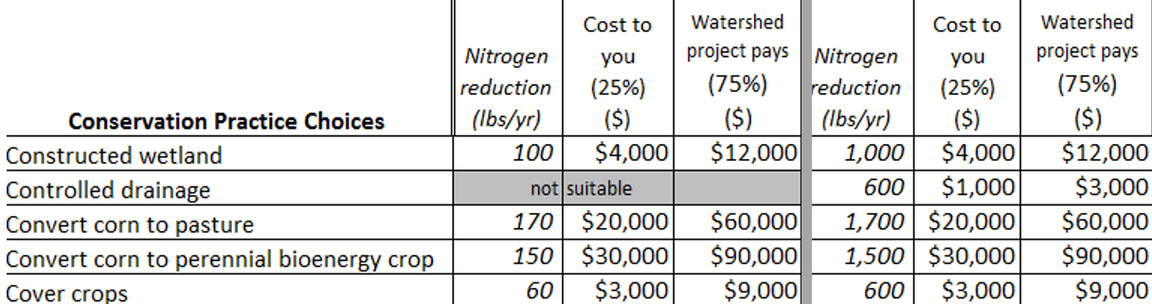
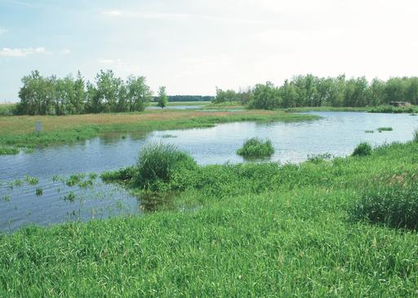
Constructed wetland
(2% of field area + buffer)
Nitrogen loss reduction: 50% (100 lbs/yr for undrained field; 1,000 lbs/yr for drained field)
Cost: $40/acre treated/year; $16,000 for 4 years;
  Farmer pays $4,000,
  Grant (i.e., the public) pays $12,000)
Photo courtesy NRCS

Slide 20
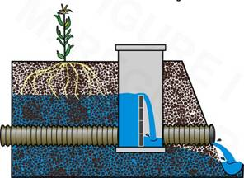
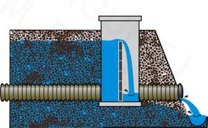
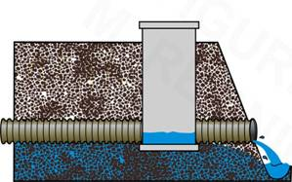
Controlled drainage
(a.k.a. drainage water management)
Nitrogen loss reduction: 30% = 600 lbs/yr for tile drained (not suitable for undrained)
Cost: $10/acre year ($1,000/year for 100 acres, $4,000 for 4 years)
Before planting or harvest
After planting
After harvest
Notes:
20

Slide 21
Controlled drainage
(a.k.a. drainage water management)
Notes:
Controlled drainage, also known as drainage water management, gives farmers the ability to manage tile water by raising the outlet elevation using a water control structure during periods when drainage is unnecessary. This raises the water table in the field until it is higher than the outlet, when it can flow freely into the drain.

Slide 22
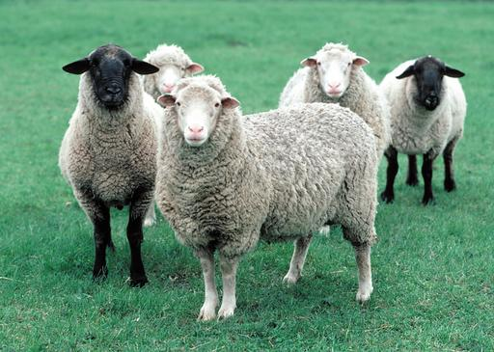
Convert row crops to pasture
Nitrogen loss reduction: 85% = 170/1,700 lbs/yr
Cost: $200/acre/year = $80,000 for 4 years
Photo courtesy NRCS

Slide 23
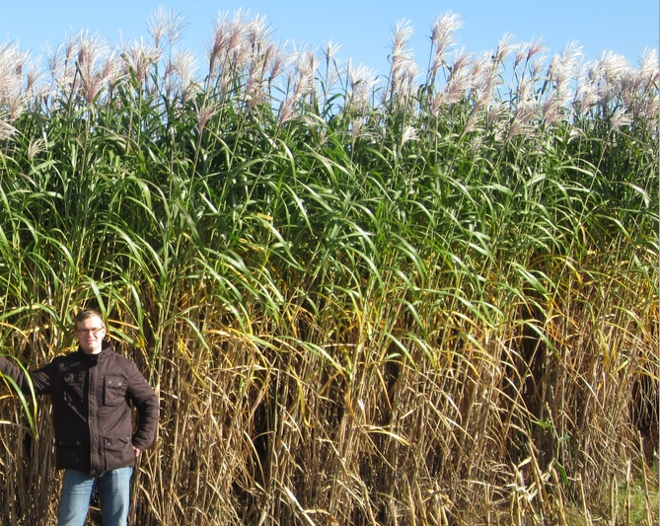
Convert to Perennial Bioenergy Crop
Nitrogen loss reduction: 75% = 150/1,500 lb/yr
Cost: $300/acre/year = $120,000 for 4 years

Slide 24
Cover crops
N loss reduction: 30% = 60/600 lbs/yr
Cost: $30/acre/year (This is very controversial but based on findings in Iowa.) = $12,000 for 4 years
Photo courtesy NRCS

Slide 25
Denitrifying Bioreactor
N loss reduction: 40%, tile-drained only
Cost: $10/acre treated/year = $4,000 for 4 years
Photo courtesy L. Gentry, U of I

Slide 26
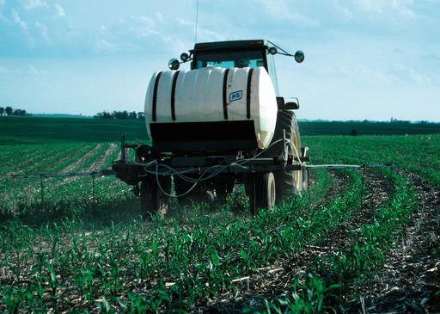
Fertilizer Rate –
Apply N at Maximum Return to Nitrogen
N loss reduction: 10%
Cost: --$2/acre (This is recommended rate, but often exceeded.)
Photo courtesy NRCS

Slide 27
Fertilizer Timing –
Apply N after planting (sidedress)
N loss reduction: 5% = 10 / 100 lb/yr
Cost: $12/acre = $4,800 for 4 years
Fertilizer Timing -- Apply N as sidedress
Photo courtesy NRCS

Slide 28
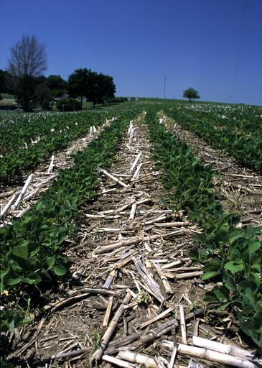
No-Till
N loss reduction: 0%
Cost $20/acre/year = $8,000 for 4 years
Photo courtesy NRCS

Slide 29
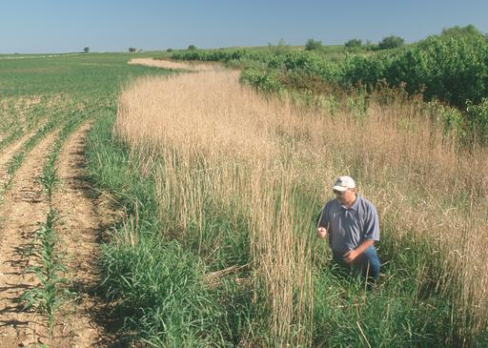
Riparian buffer strip
(approximately 2% of field)
N loss reduction: 2% = 4 lbs/yr or 40 lbs/yr
Cost: $30/acre treated/year = $12,000 for 4 years
Photo courtesy NRCS

Slide 30
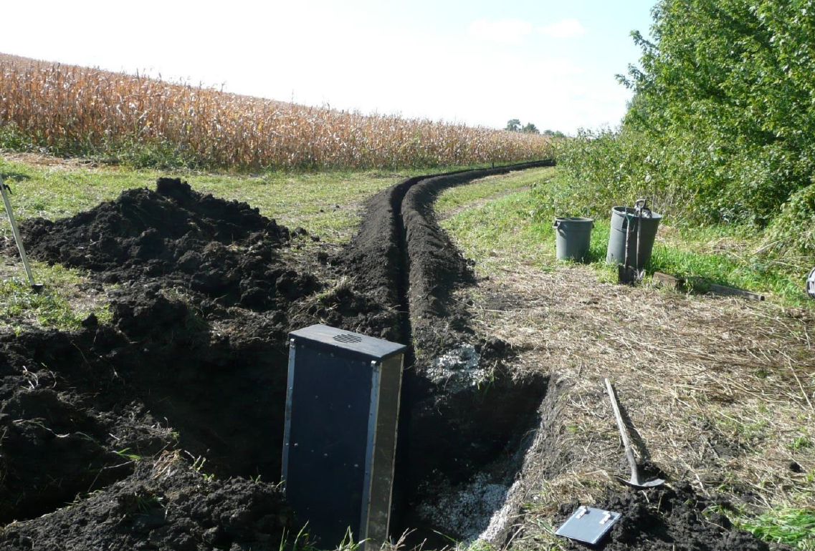
Saturated buffer = redistributing water from tile line into buffer
N loss reduction: 50% - only for tiled fields, where buffers already exist (you decide if true for your field)
Cost: $10/acre treated/year = $4,000 for 4 years
Drainage from field
,
Photo courtesy NRCS
Photo courtesy Dan Jaynes, USDA-ARS)

Slide 31
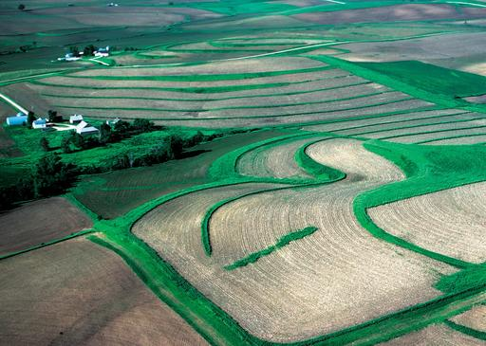
Terraces
N loss reduction: 2% = 8 or 80 lb/yr
Cost: $10/acre/year = $4,000 for 4 years
Photo courtesy NRCS

Slide 32
What practices reduce dissolved phosphorus from drained fields?
To improve water quality we must reduce dissolved nitrogen and phosphorus in drains.

Slide 33
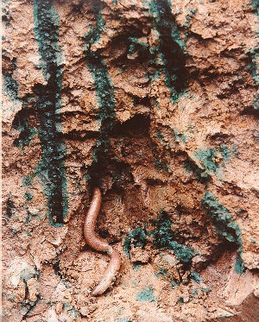
Phosphorus moves differently than nitrogen
Robust research for decades shows that flow is through “macropores”, caused by worms, roots, or cracks.
Unfortunately, healthy soil has more of these.

Slide 34
We know what does not remove dissolved P very well
Cover crops
Bioreactors
No-till
Wetlands or two-stage ditches can work if we harvest the plants to remove the phosphorus.

Slide 35
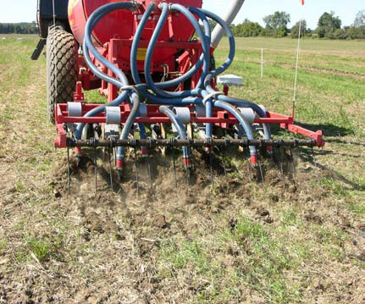
Top practices: (1)Apply all phosphorus below the soil surface
Applying fertilizer in the soil, not on the soil, substantially reduces phosphorus in surface runoff and also tile drains.

Slide 36
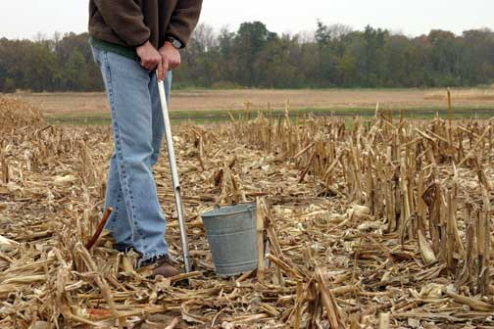
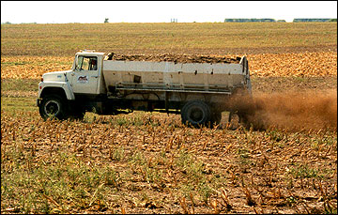
(2)Do not exceed recommended soil test phosphorus levels
http://Ipm.iastate.edu

Slide 37
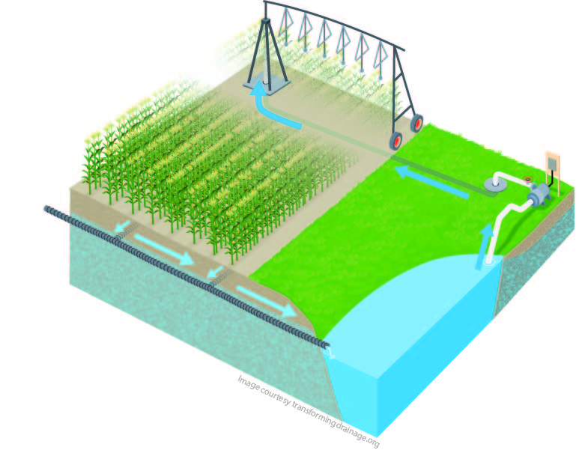
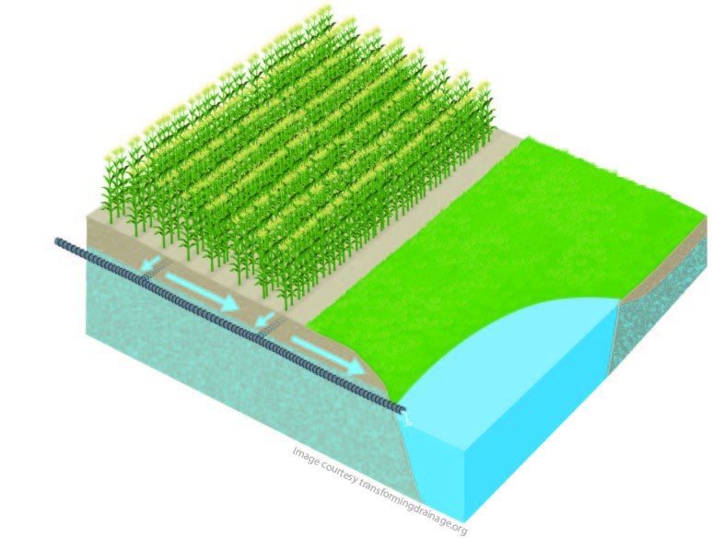

Potential new practice:
Drainage water recycling
Stores drained water in a pond
and irrigates it back onto crops later in the season

Slide 38
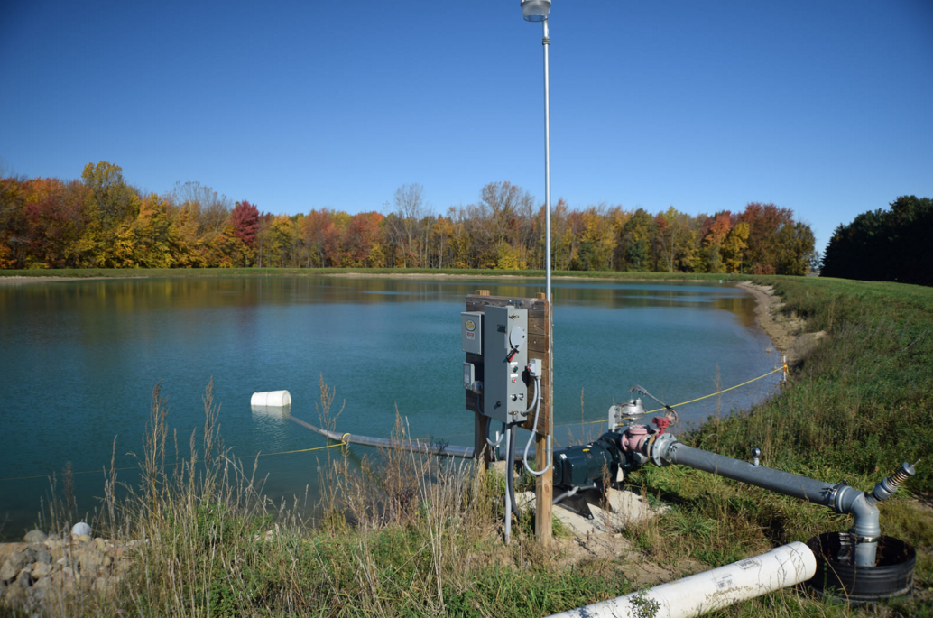
This is an old idea, being revived to meet tomorrow’s water management challenges

Slide 39
After the break,
Nutrient Reduction Game

Slide 40
The Nutrient Reduction Game
What will it take to successfully implement a Nutrient Reduction Strategy?

Slide 41
Farmers in the Green Ditch Watershed have formed a group.
They have received a $30,000 grant to reduce nitrogen load. Goal is 45% reduction.
Today
Green Ditch Watershed Ag Council.
$30K
Twenty thousand and 00/100

Slide 42
McDonald Farm (rented)
Brooks Big Farm
Sunshine Small Farm

Slide 43
Playing the game
You will play the role of one producer who owns or rents two 100-acre fields in the watershed
2 to 3 people share this role to encourage discussion).
You have a little information about the farmer you represent; please feel free to make up any additional information.
You should act as you think this farmer would be likely to act.
(But have fun.)

Slide 44
Playing the game
In each round, each “producer” can place one practice on one field if he/she wishes. (Also can “pass”.)
Whoever is ready first can implement a practice.
  No one can implement a second practice until all have had a chance to do one.
To implement a practice,
  lay a practice card down on that field,
  pay your share of the implementation costs to the banker, and
  subtract the reduction in nitrogen loss for your field, and write the new total for the field.

Slide 45
Will farmers do this? You decide.
Watershed Coordinator Goal: Achieve a 45% reduction.
Producers’ Goal: Each may be different; your chance to think through how conservation might fit into a farm family’s outlook and goals.

